Slide 1
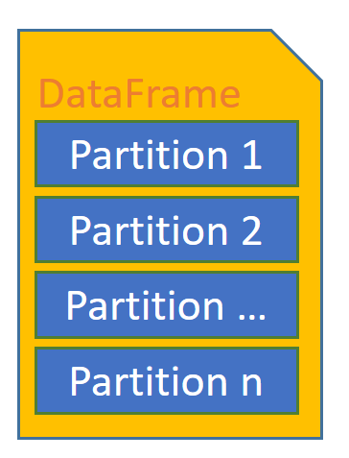
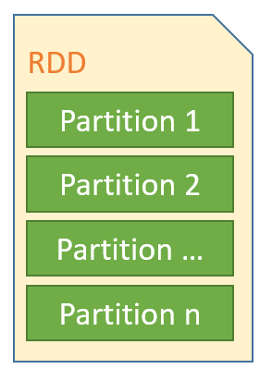


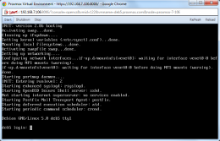
sparkContext
sqlContext
docsInPath
indexOutPath
sqlContext
indexInPath
sparkContext
indexDataFrame
words
numDocsToDisplay
HDFS
HDFS
Load doc files into RDD
Document Files
RDD
Convert RDD into DataFrame
TF-IDF Index
Load index
tf_idf_index
Partition 1
Partition 2
Compute Search Results
Partition …
Partition n
Build TF-IDF Index
Display Results
TF-IDF Index
Save TF-IDF to Parquet
build_tf_idf_index
load_tf_idf_index
match_words

Slide 2
DataFrame
Partition 1
Partition 2
Partition …
Partition n

